Slide 2
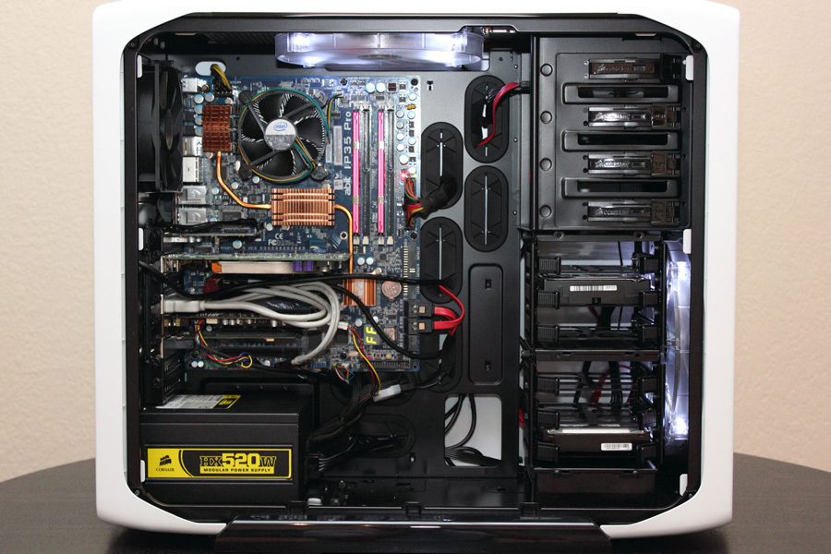
Cooling Fan
Memory Board
DVD Drive
USB Port
Monitor port
Ethernet port
Audio Port
Power Supply
Hard drive
Mother Drive

